Slide 1
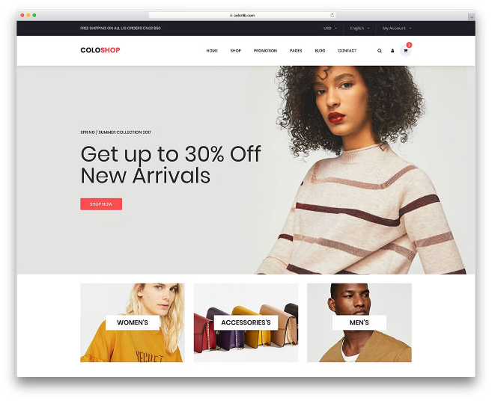
E-commerce Recommendation System
Team Members:-
Shubham Kumar Gupta
(RA2211003010534)
Kavin sundareshwaran (RA2211003010561)
Kartik pashupathi
(RA2211003010555)

Slide 2

Problem Statement
Building an E-Commerce Recommendation System
In today's digital landscape, e-commerce platforms are thriving, offering users a vast array of products to explore. However, with so many choices, it can be challenging for customers to find items that truly match their preferences. This is where recommendation systems come into play, enhancing the user experience by providing personalized product suggestions. In this comprehensive guide, we'll delve into the process of building an e-commerce recommendation system using Flask and machine learning techniques, including content-based, collaborative filtering, hybrid, and multi-model approaches.

Slide 3

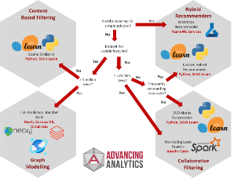
Understanding Recommendation Systems
1
Content-based Recommendation
2
Collaborative Filtering
Content-based recommendation systems analyze item attributes and user preferences to suggest similar products. They focus on matching user interests with item features to provide personalized recommendations.
Collaborative filtering recommendation systems leverage user behavior data, such as ratings and interactions, to make predictions and suggest items that users with similar preferences have enjoyed.
3
Hybrid Recommendation
4
Multi-model Recommendation
Hybrid recommendation systems combine multiple approaches, such as content-based and collaborative filtering, to provide more accurate and diverse recommendations, catering to a wider range of user preferences.
Multi-model recommendation systems integrate different machine learning models to offer personalized suggestions, addressing the unique needs and preferences of individual users.

Slide 4
Building the Recommendation System
Data Collection and Preprocessing
Content-based Recommendation
Collaborative Filtering
We'll start by gathering and preparing the e-commerce dataset, including product attributes, user ratings, and interaction data. This step is crucial for ensuring the accuracy and effectiveness of our recommendation system.
We'll implement content-based recommendation algorithms to suggest products based on their features and user preferences. By analyzing item attributes and user behavior, we can provide personalized recommendations that cater to individual tastes.
We'll develop collaborative filtering models using techniques like matrix factorization and neighborhood-based methods to predict user-item interactions. This will allow us to leverage user behavior data to make accurate recommendations.

Slide 5

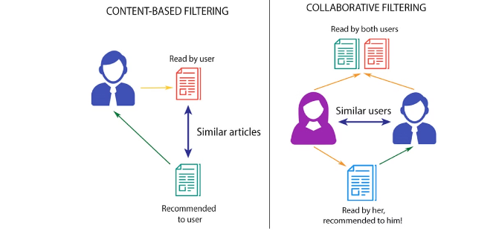
Enhancing the Recommendation System
1
Hybrid Models
To further improve recommendation accuracy and coverage, we'll create hybrid models that combine content-based and collaborative filtering approaches. By leveraging the strengths of both methods, we can deliver more comprehensive and personalized suggestions.
2
Multi-model Recommendations
In addition, we'll explore multi-model recommendation strategies, integrating multiple machine learning models to provide diverse recommendations that cater to the unique preferences of each user.
3
Evaluation and Optimization
Throughout the development process, we'll continuously evaluate the performance of our recommendation system and make necessary adjustments to optimize its accuracy, diversity, and user satisfaction.

Slide 6
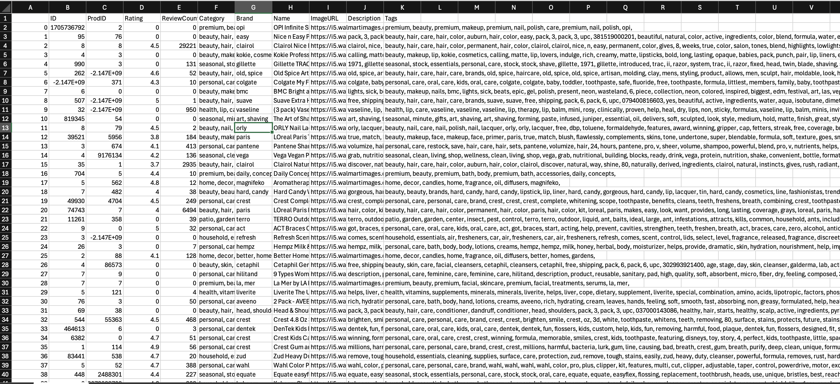
DATASET

Slide 7
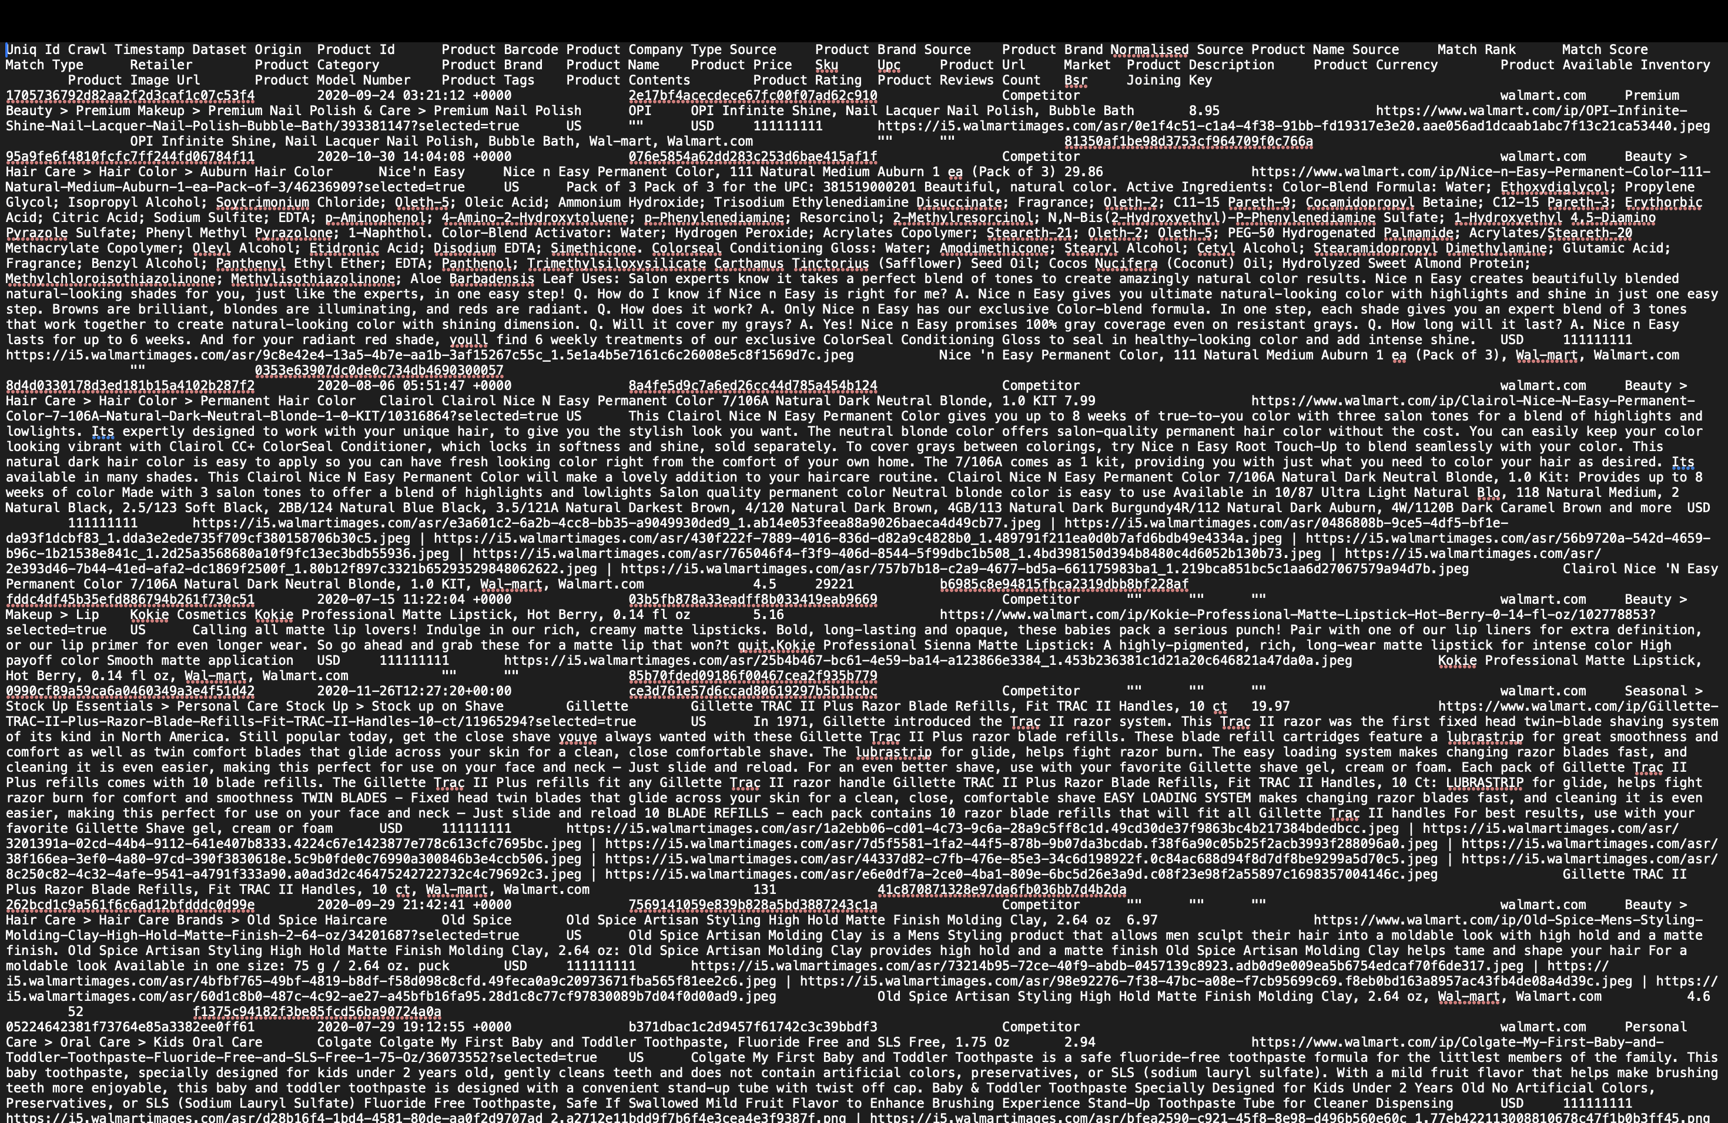
DATASET

Slide 8
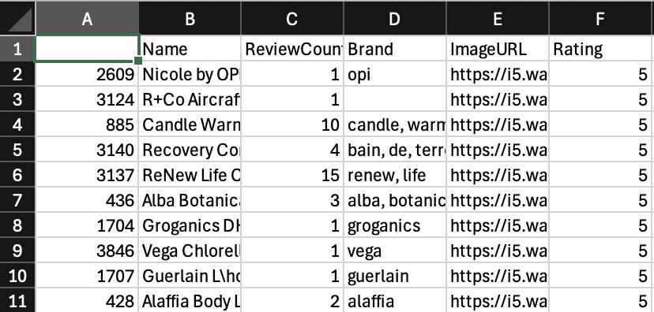
DATASET

Slide 9

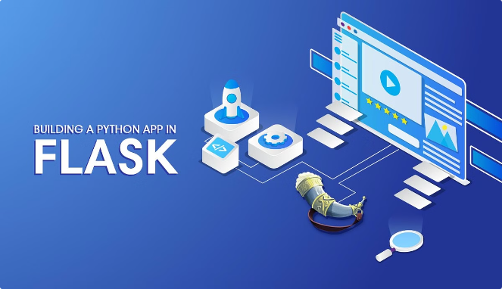
Integrating the Recommendation System with Flask
Flask Web Application
We'll create a Flask-based web application to provide a user-friendly interface for our e-commerce recommendation system. The application will include features such as user registration, product browsing, search functionality, and personalized recommendation display.
User Authentication and Session Management
To ensure a secure and seamless browsing experience, we'll implement user authentication and session management within the Flask application. This will allow us to personalize the recommendations based on each user's preferences and interactions.
Dynamic Recommendation Display
The e-commerce website will feature product cards displaying essential information, including images, descriptions, prices, and ratings. Users will have the option to interact with the recommendation system by providing feedback, such as ratings and likes, to improve future suggestions.

Slide 10


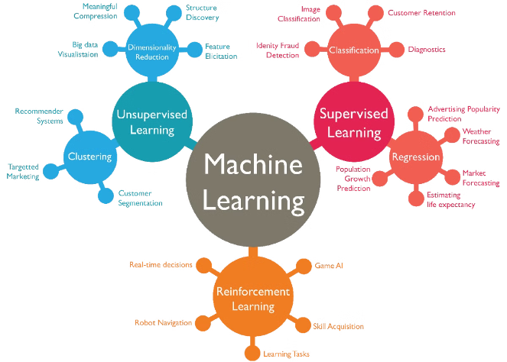



Leveraging Machine Learning Techniques
Neural Networks
We'll explore the use of neural networks, such as deep learning models, to capture complex user-item interactions and provide highly personalized recommendations.
Decision Trees
Decision tree-based models can be employed to identify patterns in user behavior and item features, enabling us to make targeted product suggestions.
Clustering
Clustering algorithms can group users with similar preferences, allowing us to leverage collaborative filtering techniques more effectively.
Matrix Factorization
Matrix factorization methods, such as singular value decomposition (SVD), can be used to uncover latent user-item relationships and make accurate recommendations.

Slide 11


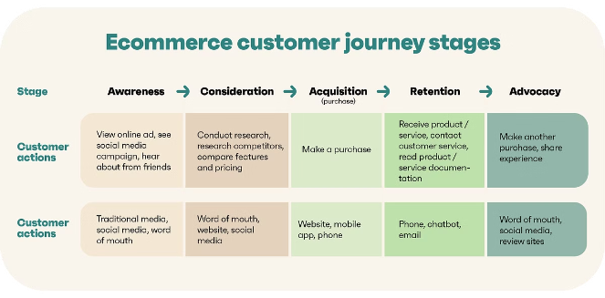


Improving the User Experience
Personalization
By leveraging the recommendation system, we can deliver personalized product suggestions that cater to each user's unique preferences, enhancing their shopping experience and increasing customer satisfaction.
Engagement
The integration of the recommendation system with the Flask-based e-commerce website will encourage users to engage more with the platform, explore new products, and discover items they might have otherwise overlooked.
Loyalty and Retention
Providing a seamless and personalized shopping experience through the recommendation system can foster customer loyalty, leading to increased sales, repeat business, and long-term customer retention.

Slide 12


Conclusion
Key Takeaways
Benefits of E-Commerce Recommendation Systems
- Leverage content-based, collaborative filtering, hybrid, and multi-model approaches for personalized recommendations - Integrate the recommendation system with a Flask-based e-commerce website for a seamless user experience - Utilize machine learning techniques, such as neural networks, decision trees, clustering, and matrix factorization, to enhance recommendation accuracy - Focus on improving user personalization, engagement, and loyalty to drive business growth
- Enhance user experience and satisfaction by providing personalized product suggestions - Increase sales and revenue through improved product discovery and targeted recommendations - Foster customer loyalty and retention by delivering a seamless and tailored shopping experience - Gain valuable insights into user preferences and behavior to inform business decisions

